Slide 1

Predicting the Severity of a Volcanic Eruption
Devon Myers

Slide 2
Questions to answer
Can we construct a model to predict eruption severity?
2. Does missing value imputation increase model accuracy?
3. Does an imbalanced dataset decrease model accuracy?

Slide 3
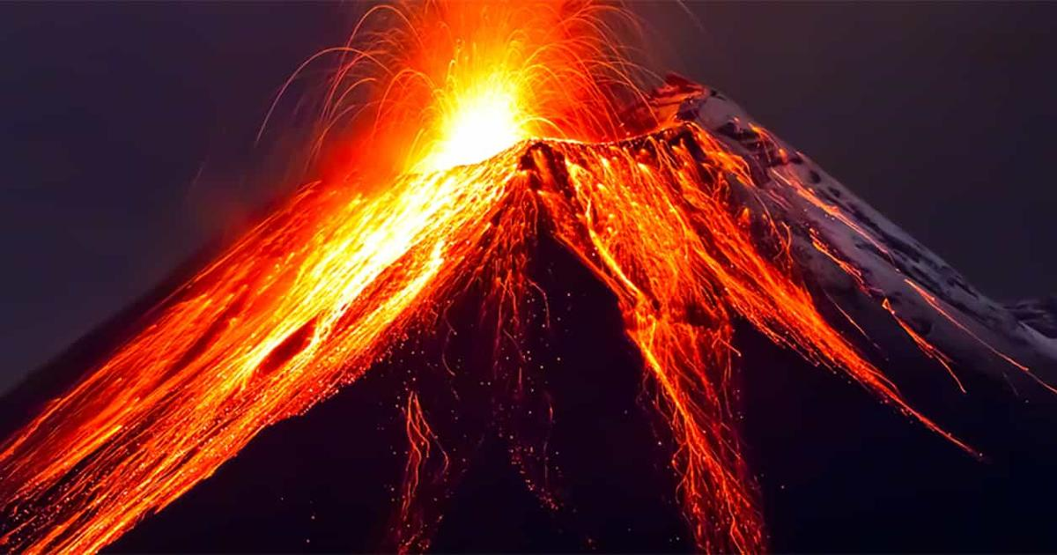
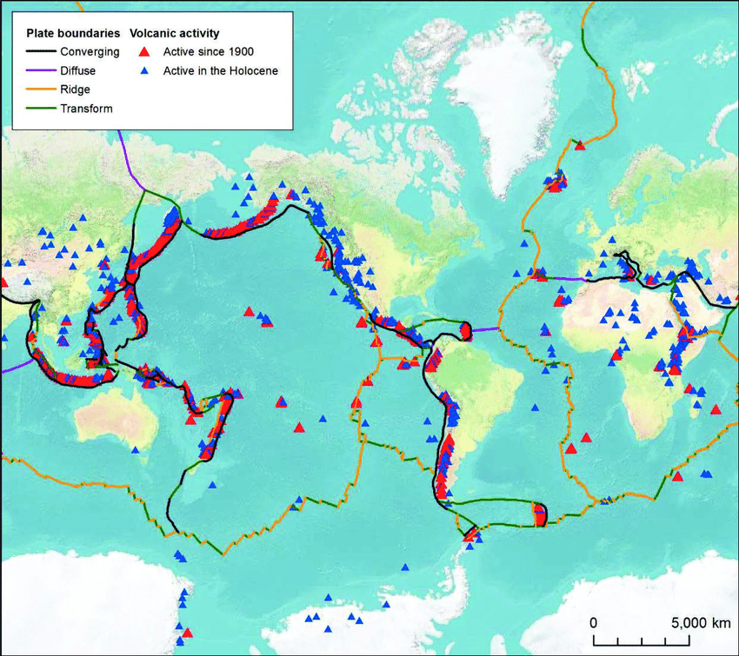
Volcanoes
Landforms that typically form when tectonic plates interact
Can spew gas, ash, and magma (molten rock) from the Earth’s interior during an eruption
1337 known volcanoes on Earth

Slide 4

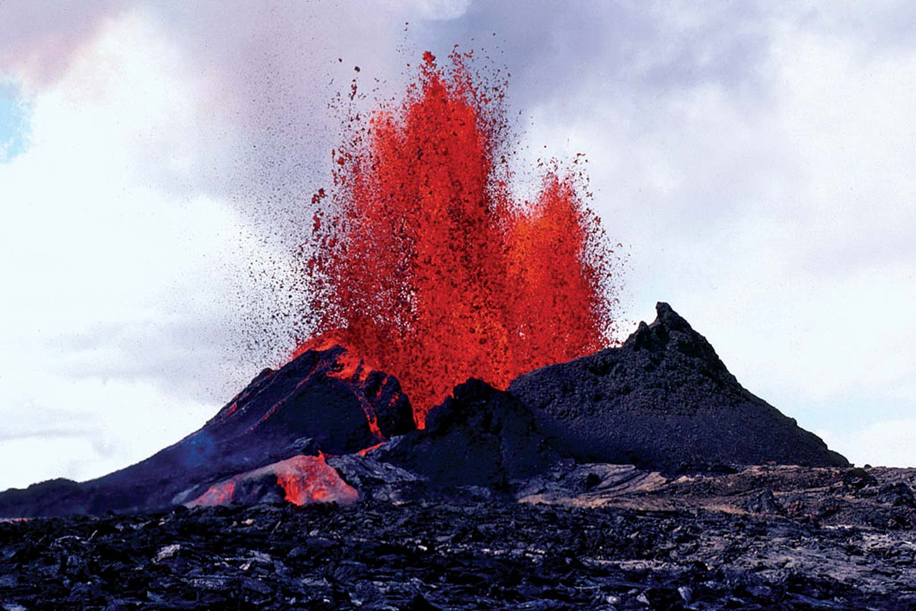

Types of volcanoes
There are many types of volcanoes on Earth
Stratovolcanoes
Mt. Fuji
Mt. Saint Helens
Shield Volcanoes
Hawaiian Islands
Mount Kilauea
Submarine Volcanoes
Kick ‘em Jenny

Slide 5
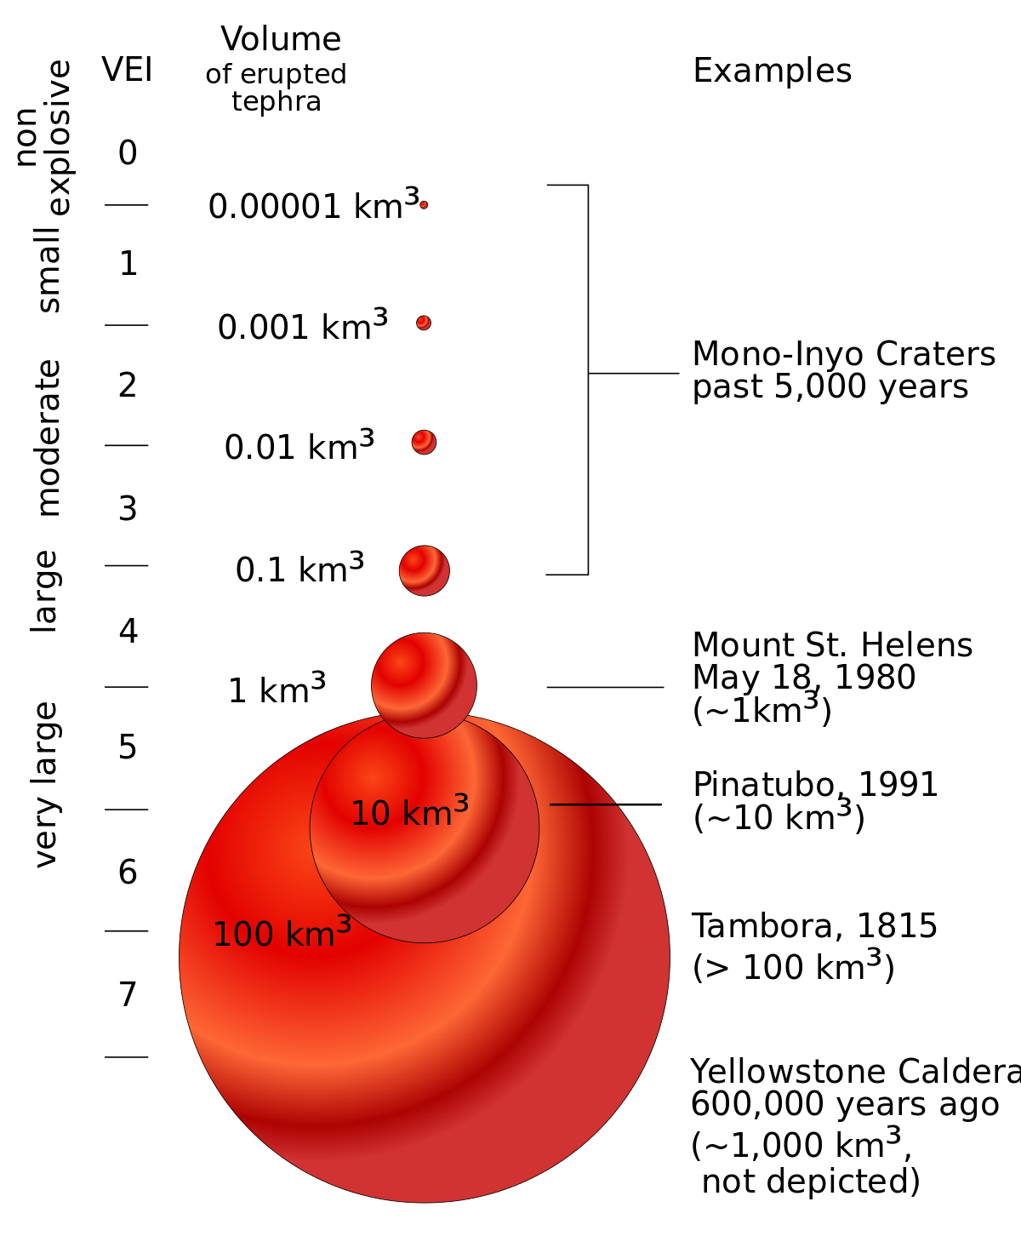
Measuring Eruption severity
Volcanic Explosivity Index (VEI)
Logarithmic scale that describes the severity of an eruption based on magnitude and the intensity
This is the dependent variable for analysis

Slide 6
Variables For analysis
Ordinal Outcome Variable | Continuous Independent Variables | Nominal Independent Variables
VEI | Latitude | Country
 |  | Volcano Type
 | Longitude | Region
 |  | Rock Type
 | Elevation | Tectonic Setting

Slide 7

Eruption Data
Collected from the Smithsonian’s Global Volcanism Project
Observations of 11,114 eruptions from the last 10,000 years

Slide 8
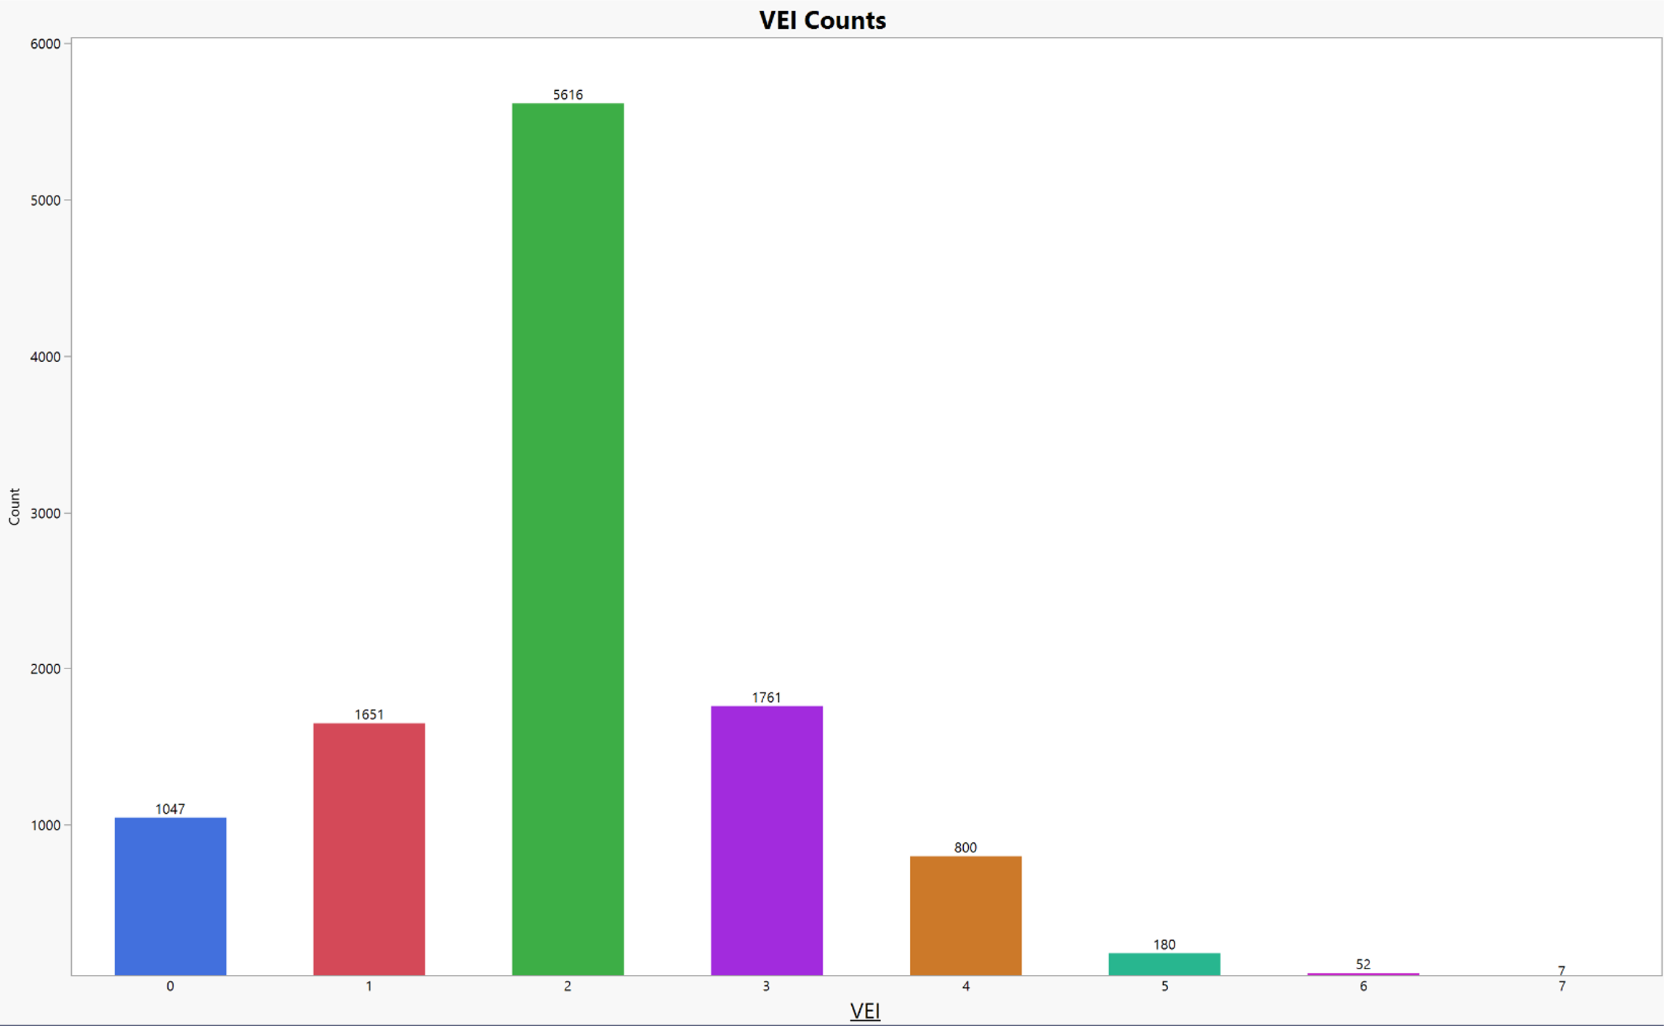
Imbalanced Dataset
Way more eruptions with VEI = 2 than any other VEI level!
Denote VEI = 2 as the majority class
This can cause classifiers to misclassify minority classes (i.e. VEI other than 2)

Slide 9
Data treatment
2831 observations missing VEI
K-NN imputation for missing values
Simple oversampling to rectify imbalance in VEI
For each minority class, resample observations until class frequency matches the majority class
Min/max scaling of continuous variables
Dichotomization of nominal independent variables

Slide 10
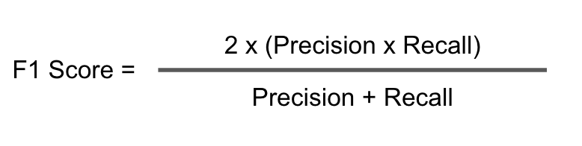
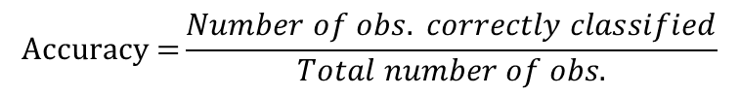
Models & Performance
Performance metrics:
Fit time (in seconds)
F1 Score
Accuracy
10-fold cross-validation on training data
$$\text{Accuracy}\text{ =}\frac{Number of obs. correctly classified}{Total number of obs.}$$

Slide 11
Effect of data treatment
To compare the effects of imputation and oversampling, model performance for each of the following datasets were compared:
Non-oversampled, non-imputed data
Non-oversampled, imputed data
Oversampled, non-imputed data
Oversampled, imputed data

Slide 12
Models & Performance
Classifiers used to predict VEI:
Logistic Regression
Naïve Bayes
K-Nearest Neighbors
Decision Trees
Random Forests
Gradient Boosted Trees
Gradient boosted trees, though slow, had the best F1 and accuracy
scores out of the six classifiers
Gradient Boosted Trees Training Performance | Non-oversampled, non-imputed | Non-oversampled, imputed | Oversampled, non-imputed | Oversampled, imputed
Fit time (s) | 67.00 | 138.0 | 280.6 | 573.5
F1 | 0.544 | 0.618 | 0.649 | 0.702
Accuracy | 0.579 | 0.647 | 0.660 | 0.707

Slide 13
Oversampling and imputation
Gradient Boosted Trees Training Performance | Non-oversampled, non-imputed | Non-oversampled, imputed | Oversampled, non-imputed | Oversampled, imputed
Fit time (s) | 67.00 | 138.0 | 280.6 | 573.5
F1 | 0.544 | 0.618 | 0.649 | 0.702
Accuracy | 0.579 | 0.647 | 0.660 | 0.707
Imbalanced data drags down accuracy of classifiers
Oversampling and imputation appear to increase fit time, F1 score, and accuracy on for training data
What about generalizability?

Slide 14
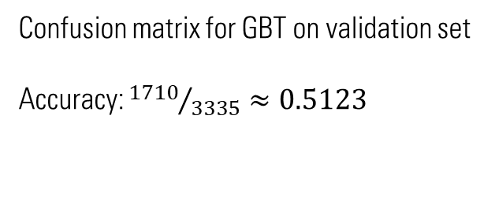
Validation Accuracy… not so good
Actual | Predicted
 |  | 0 | 1 | 2 | 3 | 4 | 5 | 6 | 7
 | 0 | 312 | 14 | 19 | 17 | 19 | 5 | 8 | 0
 |  | 45 | 240 | 119 | 61 | 26 | 28 | 21 | 1
 | 1
 |  | 109 | 249 | 818 | 215 | 75 | 105 | 49 | 5
 | 2
 |  | 18 | 43 | 95 | 200 | 43 | 39 | 8 | 3
 | 3
 |  | 7 | 16 | 27 | 43 | 111 | 35 | 19 | 1
 | 4
 |  | 1 | 1 | 4 | 8 | 8 | 25 | 1 | 0
 | 5
 |  | 0 | 1 | 4 | 1 | 3 | 4 | 4 | 0
 | 6
 |  | 0 | 1 | 0 | 0 | 0 | 0 | 0 | 0
 | 7
Confusion matrix for GBT on validation set
Accuracy: ${1710}/{3335}≈0.5123$

Slide 15

Can we predict severity of a volcanic eruption?
YES!
… just not very accurately

Slide 16
Conclusions & Moving forward
Imbalanced data can lead to problems predicting minority class
Imputation and oversampling may VEI prediction training performance, but decrease generalizability
Possible improvements:
Try different kinds of imputation
More complicated oversampling techniques like SMOTE
Try new models: artificial neural networks, SVM

